Slide 1
The Management System for Student Organizations
Group 15: Yu Chenxi
Fu Xinyu
Tu Yuan

Slide 2


Xinyu Once faced a problem:
Miss the time to join his favorite club !
Problems faced by JLU students:
Do not have an unified system to get informations about all the student organizations.

Slide 3

Analysis ---- what JLUers need ?
For Organizer :
1) Publishing their notice
2) Collecting applications
3) Publishing grades
For Students :
1) Searching all recruiting information
2) Finding their favorite clubs
3) Submiting applications

Slide 4
Design ---- How we fulfill our task?
Start
Personal account&
enrollment
window
Activity&gra-de
Create the welcome interface
Input&save the information
Input and save the information
Create the main menu
Research the information
Announcement of information
Concordance three parts
End

Slide 5
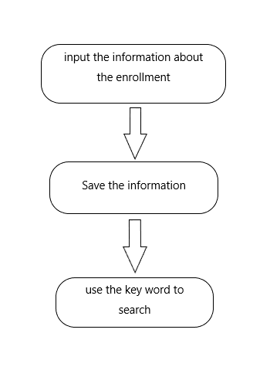
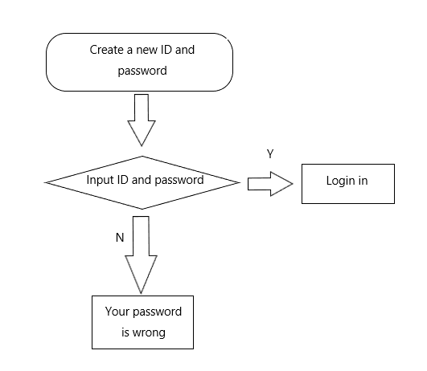
Login part & enrollment part

Slide 6
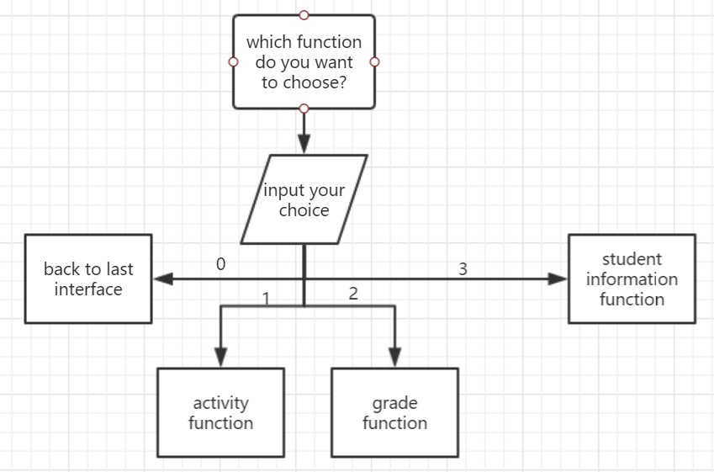
Interface

Slide 7
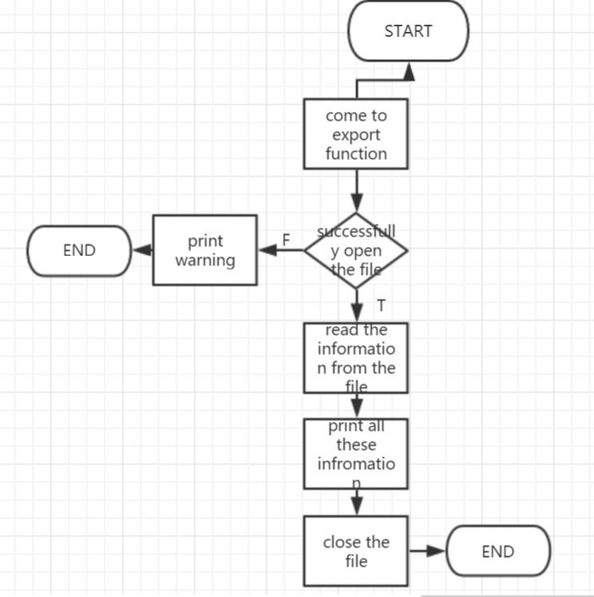
Export function

Slide 8


Main functions
ACTIVITY PART (Made by Yu chenxi)
registration notice & examination grades
PERSONAL ACCOUNT PART (Made by Fu Xinyu)
log-in part & submit application
MENU PART (Made by Tu Yuan)
a smart interface & integrade functions

Slide 9
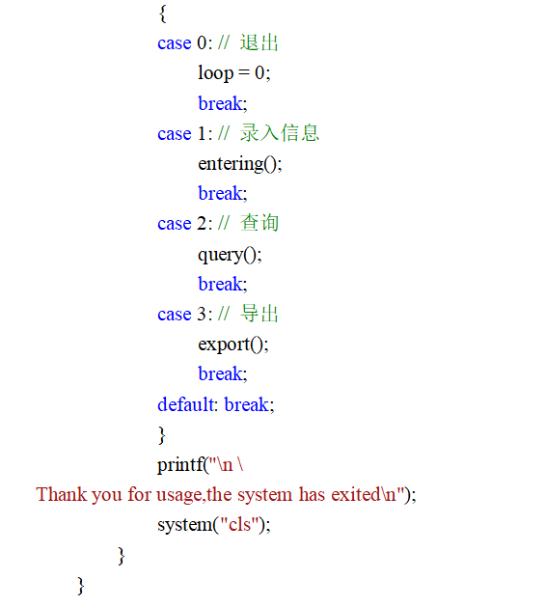
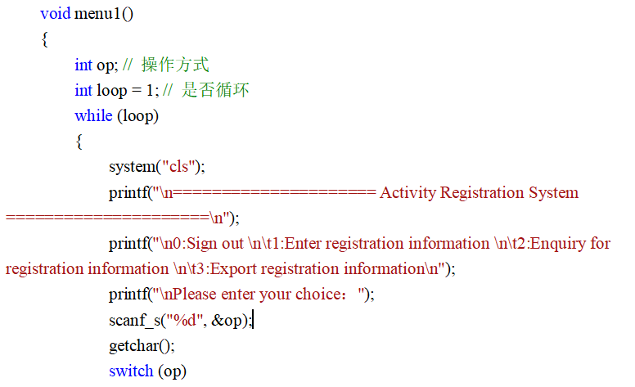
MENU PART

Slide 10
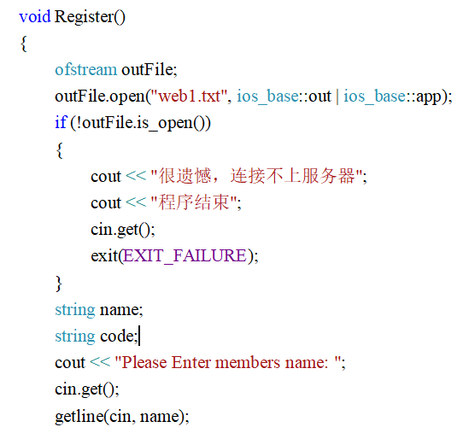
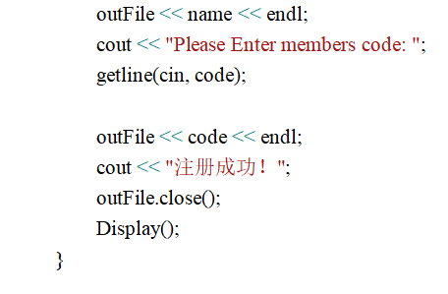
Register part

Slide 11
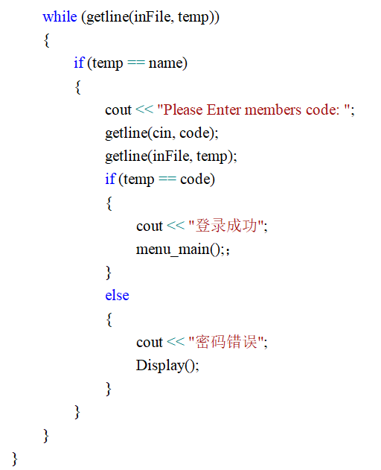
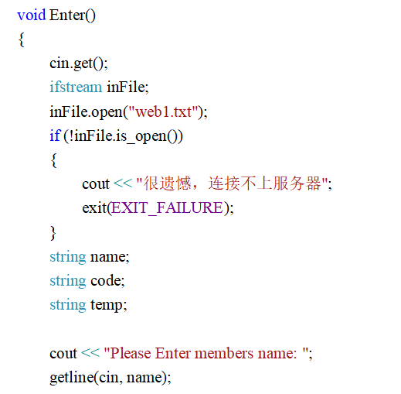
Log in part

Slide 12
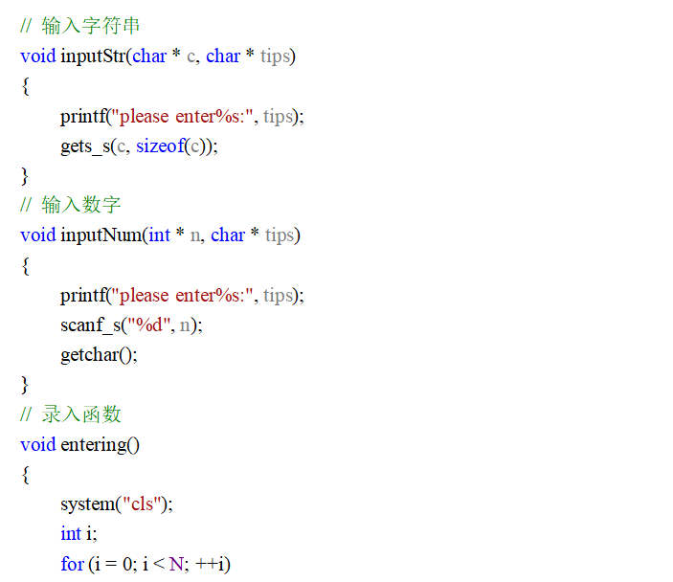
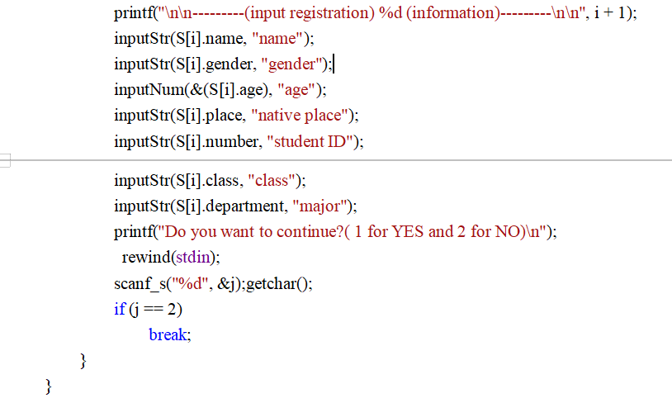
submit/find the grade and student information

Slide 13
TEST

Slide 14
Thank you for your carefully listening!
Group 15

